Slide 1


CRUK cluster introduction (II of III)
Using the scheduler for job submission

Slide 2
Overview
SLURM (Simple Lightweight Unix Resource Manager)
In their own words:
‘Slurm is an open source, fault-tolerant, and highly scalable cluster management and job scheduling system for large and small Linux clusters. Slurm requires no kernel modifications for its operation and is relatively self-contained. As a cluster workload manager, Slurm has three key functions. First, it allocates exclusive and/or non-exclusive access to resources (compute nodes) to users for some duration of time so they can perform work. Second, it provides a framework for starting, executing, and monitoring work (normally a parallel job) on the set of allocated nodes. Finally, it arbitrates contention for resources by managing a queue of pending work..’
SLURM will allow you to:
Submit jobs to the cluster.
Specify which queue/account to submit your jobs to.
Request memory resources for your jobs.
Set memory limits for your jobs.
Set time limits for your jobs
Check the status of the jobs you have submitted.
Check the status of the hosts within the cluster.
Kill jobs that you have submitted to the cluster.

Slide 3
The most useful SLURM commands
These are:
srun
sbatch
sacct
squeue
scancel
Type command followed by -h for usage details.
Usage: srun [OPTIONS...] executable [args...]
Parallel run options:
-A, --account=name charge job to specified account
--acctg-freq=<datatype>=<interval> accounting and profiling sampling
intervals. Supported datatypes:
task=<interval> energy=<interval>
network=<interval> filesystem=<interval>
…
Help options:
-h, --help show this help message
--usage display brief usage message
Other options:
-V, --version output version information and exit

Slide 4
The most useful LSF commands
These are:
bsub
bjobs
bhosts
bqueues
bkill
Type command followed by --help for usage details (some accept –h).
Many LSF commands have shared syntax,
i.e. the -l (long output), -u (User) and -m (host) flags.

Slide 5
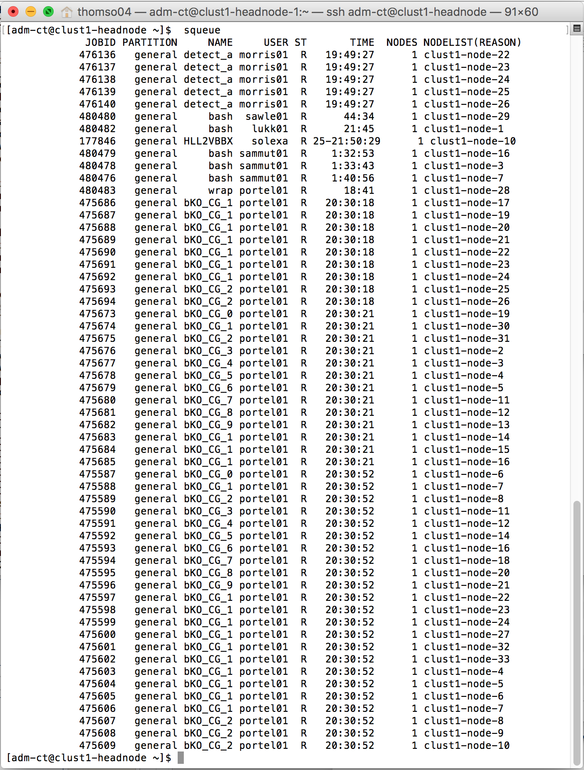
A Job
A command or series of commands submitted to the cluster with associated resource requirements and limits.
Status of jobs running on the cluster can be seen with the command
clust1-headnode $ squeue

Slide 6
Output from SLURM
clust1-headnode > squeue
[obrien04@clust1-headnode ~]$ squeue
JOBID PARTITION NAME USER ST TIME NODES NODELIST(REASON)
427309 general RK307bam lukk01 PD 0:00 1 (Dependency)
427311 general RK309bam lukk01 PD 0:00 1 (Dependency)
…
436869 general mutect2. wan01 R 4:25:25 1 clust1-node-16

Slide 7
The bsub command
A monster, even by unix standards.
bsub [ -h ] [ -V ] [ -H ] [ -x ] [ -r ] [ -N ] [ -B ] [ -I | -Ip | -Is | -K ]
[ -T time_event ]
[ [ -X "exception_cond([params])::action" ] ... ]
[ -w depend_cond ]
[ -q queue_name ... ] [ -a application_name ]
[ -m host_name[+[pref_level]] ... ]
[ -n min_proc[,max_proc] ]
[ -R res_req ]
[ -J job_name_spec ] [ -b begin_time ] [ -t term_time ]
[ -i in_file ] [ -o out_file ] [ -e err_file ]
[ -u mail_user ] [ [ -f "lfile op [ rfile ]" ] ... ]
[ -E "pre_exec_command [ argument ... ]" ]
[ -c cpu_limit[/host_spec ] ] [ -W run_limit[/host_spec ] ]
[ -F file_limit ] [ -M mem_limit ] [ -D data_limit ]
[ -S stack_limit ] [ -C core_limit ]
[ -k "chkpnt_dir [ chkpnt_period ]" ] [ -w depend_cond ]
[ -L login_shell ] [ -P project_name ]
[ -G user_group ] [ command [ argument ... ] ]

Slide 8
A Queue:
A queue for job submissions associated with specified users and cluster hosts, and
providing specified default resources.
SLURM calls queues ‘partitions.’
We have a single general ‘partition’, with few restrictions (currently).
Most CRI cluster queues have a default memory resource limit of 2GB per job.
You can override the default by adding the
-M <memory size in KB>
to the bsub
command.
An example submission request to the queue named cluster to run a job which overrides the 2GB memory limit allowing the job to use 4GBs and requesting that the host has/hosts have 4GB memory available, may look like this:
uk-cri-lcst01 > bsub -q cluster -M 4194304 -R "rusage[mem=4096]" <command>

Slide 9
Checking the status of hosts within the cluster
SLURM
Clust1-headnode > sinfo
[obrien04@clust1-headnode ~]$ sinfo
PARTITION AVAIL TIMELIMIT NODES STATE NODELIST
general* up infinite 15 mix clust1-node-[1-7,9,12-16,18,21]
general* up infinite 18 idle clust1-node-[8,10-11,17,19-20,22-33]

Slide 10
Killing jobs with scancel
clust1-headnode $ scancel <job-id>

Slide 11
Running scripts with LSF
Script must be executable, the linux chmod command can be used
to set the executable attribute
uk-cri-lcst01> chmod u+x /lustre/xxlab/xxuser/xxscript.sh
The script can then also be run by redirecting it to the bsub command using one of the linux redirection operators "<“
uk-cri-lcst01> bsub -q cluster -M 4194304 -R "rusage[mem=4096]" < xxscript.sh
SLURM (See practical exercise II)…
You can also include BSUB options within the script i.e.
#!/bin/sh
#BSUB -o myoutput.log
#BSUB -e myerror.log
#BSUB -a R
cd /lustre/xxlab/xxuser
<command>

Slide 12

Simple Parallel Computing
Most HPC at CRI consists of breaking up your
dataset into chunks and firing off a separate job
for each chunk.
‘ Magnetisation Transfer Map Example
Here small groups of pixels from T2 weighted image slices are processed to calculate the elements of the MT map.’
(Example courtesy of Dominick McIntyre, Griffiths Group)

Slide 13
Message Passing parallel jobs
Uses the generic PJL (Parallel Job Launcher) framework. You can easily recognise it because of the use of the -a openmpi flag and mpirun.lsf
In recent versions of LSF, another framework is also available, and it permits a tight (native) integration with the MPIs (this is why there is the OpenMPI integration)
uk-cri-lcst01 > bsub -o %J.out -e %J.err -n 4 -R "span[ptile=1]" -a openmpi mpirun.lsf ./test
uk-cri-lcst01 > bsub -o %J.out -e %J.err -n 4 -R "span[ptile=1]" mpirun ./test

Slide 14
A job submission example
from Ben Davis, Bioinformatics Core Facility
‘This is a shell command line loop I ran recently... quite a good example as the actual thing running is just creating checksum files so doesn’t distract.’
‘Here multiple named jobs are submitted. Each checks a single file specified by numeric indices incorporated in the file title and creates a named output file where the title contains the job ID.’
for f in `seq 1 16`; do srun --time=0-2 -N1 -o md5cs-%J.out -J md5cs$f md5sum -c SJD_$f.md5;done;

Slide 15
Job array example
Adapted from an example by Stewart MacArthur, Bioinformatics Core Facility
‘Here is a self contained example of the basics of using job arrays. The main benefit in this case is not speed but the ability to control the number of jobs running at any one time, using the %50 notation in the sbatch... I find job arrays particularly useful for running lots of small jobs, as there is only a single job submission there is little SLURM overhead, compared to submitting 1000 separate jobs, which takes some time. Also being able to control the number of running jobs stops you swamping your queue with jobs and leaves space for others to get jobs running.’
### Generate a random big file that we want to sort, 10 Million lines
perl -e 'for (1..1E7){printf("%.0f\n",rand()*1E7)};' > bigFile
### Split the file up into chunks with 10,000 lines in each chunk
split -a 3 -d -l 10000 bigFile split
### rename the files on a 1-1000 scheme not 0-999
for f in split*;do mv ${f} $(echo ${f} |perl -ne 'm/split(0*)(\d+)/g;print "Split",$2+1,"\n";');done
### submit a job array, allowing 50 jobs to be run at anyone time
sbatch --time=1:0 --array=1-1000%50 -N1 ./sort-script.sh
### merge the sorted files together once all the jobs are finished
sort -n -m *.sorted > bigFile.sorted
### Delete the temp files
rm -f Split*
[thomso04@clust1-headnode-1 /home/thomso04]# cat sort-script.sh
#!/bin/bash
/usr/bin/sort -n /scratcha/computing/Split$SLURM_ARRAY_TASK_ID > /scratcha/computing/Split$SLURM_ARRAY_TASK_ID.sorted

Slide 16
Job dependency
SLURM allows many different ways to express dependencies, using the
--dependency switch
Some SLURM dependencies:
after:job_id[:jobid...]
This job can begin execution after the specified jobs have begun execution.
afterany:job_id[:jobid...]
This job can begin execution after the specified jobs have terminated.
afterok:job_id[:jobid...]
This job can begin execution after the specified jobs have successfully executed (ran to completion with an exit code of zero).
[clust1-headnode ~] $ sbatch job1.sh
11254323
[clust1-headnode ~] $ sbatch --dependency=afterok:11254323 job2.sh

Slide 17
Practical session II
etc

